Slide 1

ECEN 3593-001 Computer Organization
Lecture #9
5 February 2021

Slide 2


Agenda
Class Announcements
Complete Machine Language
Verification
Machine Language <-> Assembly Language

Slide 3
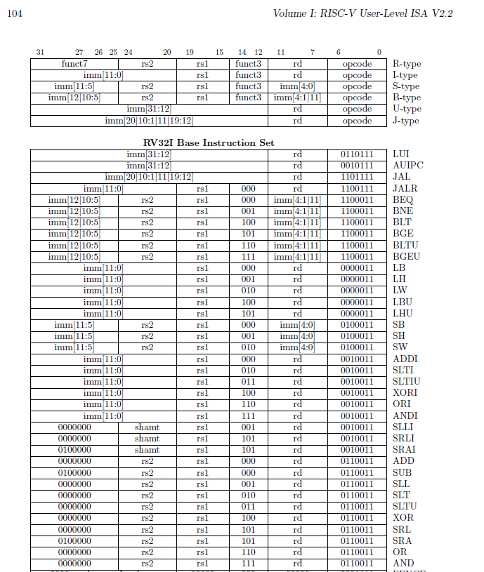
Needed later
Open the RISC-V Spec and go to page 104, open the file I sent in Slack yesterday or print one of them

Slide 4
Class Announcements
Reading for the week
“Computer Organization and Design, The Hardware / Software Interface, RISC-V edition,” by David Patterson and John Hennessy
ISBN 978-0-12-812275-4
Chapter 4, “The Processor”
pages 236-314 (sections 4.1 thru 4.8)
You must check Slack at least once per day – there are important announcements and messages
Enable notifications if necessary
Zoom OH today 2:00 to 3:00 - https://cuboulder.zoom.us/j/4317981384

Slide 5
Class Announcements
Phase 3 is posted – you will have your “bad” design as soon as Phase 2 is submitted
Let me know ASAP if you don’t see your design in your H: drive
Phase 3 Target Date Sunday, February 14 at 10:00 PM
Bonus 1%/day, deduction 5%/day

Slide 6
Class Announcements – Homework #1
Homework #1 is graded
You can see which questions you got right or wrong, but not the correct answers
Canvas may incorrectly indicate that a question is wrong – look at the awarded points

Slide 7
Homework #1A
You can make a second attempt at Homework #1
Similar random questions as Homework #1
It will be posted tonight
Due Thursday, February 11 at 10:00 PM
Your final Homework #1 score will be the average of the two attempts, but not less than Homework #1
After next Thursday, I will post the correct answers for every question that someone missed

Slide 8
Homework #1
Major Homework #1 Issues
Sign extension (also on signed memory loads, sra/i)
PC Behavior
Endianness
Hex values start with 0x, decimal values don’t

Slide 9
Sign Extension
All constants (immediates, memory offsets, branch offsets) are signed values
The sign of any constant is the highest bit which can be specified
Immediates – bit 11
Memory offsets – bit 11
Branch offsets – bit 12 (not in HW#1)
Jump offsets – bit 21 (not in HW#1)
Immediate/Memory Offset examples
0x5 -> 0x005 -> (SE) 0x00000005
0x123 -> (SE) 0x00000123
0xBC -> 0x0BC -> (SE) 0x000000BC
0xC25 -> (SE) 0xFFFFFC25

Slide 10
PC Behavior
If a starting PC is specified, it is the address of the FIRST instruction
PC normally increments by 4, except on jump or branch
Any number in a branch or jump is the branch offset value, NOT the branch address
Any valid PC value will be a multiple of 4 – in hex it will end in 0/4/8/C
Jumps and branches add the offset to the PC of the instruction, NOT to the PC + 4
The offset is RELATIVE (i.e. added to the PC) in all cases
JAL/JALR load the return address register with PC + 4, where PC is the address of the JAL or JALR

Slide 11
Class Announcements
Homework #1A due Thursday, February 11 at 10:00 PM
I will enable all correct answers for both Hopmework #1 and #1A once everyone has submitted
Homework #2 will be posted by Wednesday
Due Thursday, February 18 at 10:00 PM
Assembly <-> Machine Language
Plus additional execution questions like Homework #1

Slide 12
RISC-V Instruction Extensions
RISC-V was designed to be expandable in a number of ways
Defined “extensions”
RV32E – reduced integer instruction set for Embedded
RV64I/RV128I – integer with larger data paths
RV32/64/128M – add integer multiply and divide
RV32/64/128A – add atomic instructions for semaphores
RV32/64/128F – single precision floating point
RV32/64/128D – double precision floating point
RV32/64/128Q – quad precision floating point
RV32/64/128C – compressed (16-bit) instructions
Other placeholders (B, L, J, T, P, V, N)

Slide 13

RV64I 64-bit Memory Instruction Extensions
OPCODE – same as RV32I
New FN3 values for 64-bit load/store instructions
Why do we need LWU only in 64-bit versions?
In 32-bit architecture, no sign extension for 32-bit loads

Slide 14
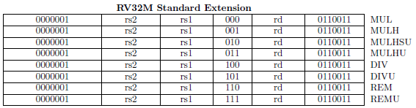
RV32M 32-bit Multiply/Divide
OPCODE – same as RV32I R-type
Same FN3 values as RV32I (isn’t that a problem?)
RV32M distinguished by FN7[0] = 1

Slide 15
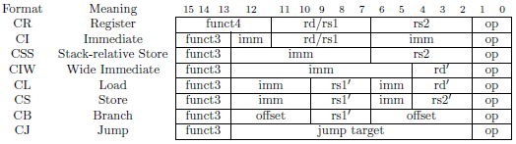
RV32C (Compressed) Instructions
RV32C defines a set of 16-bit instructions – fetch 2 at once
Fewer registers available
Smaller immediates
Uses defined registers (x1 = return register, x2 = stack pointer)
Load/store instructions are stack based
Reason for “times 2” branch/jump addressing
All other opcodes in the table have 11 in the lower 2 bits – why?
So RV32C can use other codes (00, 01, 10) as the opcode

Slide 16
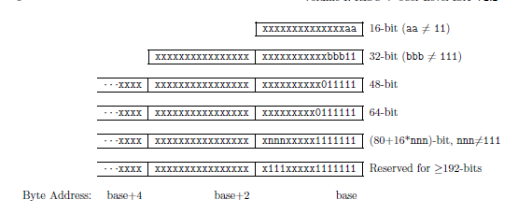
Extended Instructions
RISC-V is designed to last “forever”
Additional opcodes, which don’t conflict with the current set, have been defined for 48, 64, 128 and 192+ bit instructions

Slide 17
Verification
Verification is the process of ensuring that a hardware design is correct
For processors and systems, developing test software is a major element of verification
Verification requires a detailed understanding of hardware behavior and specifications, and software techniques
Common job for college hires – great way to learn hardware design
Verification Engineers may be the best people in an Engineering group

Slide 18
Phase 3 is Verification
You each have a unique design, with a set of 8 errors in the design
There is a list of all of the possible erroneous instructions
There is a set of known good instructions which may be used to test other instructions
The result of Phase 3 is a test program which exercises all possible failures and reports the result in a single register
Think about all the ways an instruction might fail, and then develop a test which will get different behaviors depending on whether the instruction works correctly or not
Use a branch to log the error by ORing a 1 into the appropriate bit(s) of the result register x1 if it is detected

Slide 19
Phase 3 is Verification
Instructions can fail in multiple different ways. It is unlikely that a single test will be sufficient to catch all of the errors in an instruction.
Example – an XOR might not perform an xor
Some input values may not produce an erroneous output
Each design has a correct result listed at the top of isa.codal
Scoring is a function of: (see the Phase 3 document for details):
When the test program is submitted (only 1 submission allowed)
The number of known errors in the design which are detected
The total number of possible errors which are detected (there are 14)
General code quality, thoroughness

Slide 20
“Stuck” bits
A bit (like the output of an ALU function) is defined to be “stuck” if its value is always 0 or 1 independent of the input values.
This is a very common hardware failure (open circuit or short circuit)
The ADD instruction may have one bit stuck at zero or one. You must not only detect an error, but report which bit is stuck in the result register.
Other instructions may also exhibit stuck bit behavior, but the particular bit does not need to be identified – just report an error

Slide 21
Phase 3
Questions???

Slide 22
Next Lecture
Assembly <-> Machine Language translation
RISC-V Hardware Implementation

